Slide 1
Software Engineering
UNIT - 1

Slide 2
Software and Software Engineering
Dual role of software
Software questions haven't changed
A definition of software
Differences between hardware and software
Changing nature of software
Dealing with legacy software
Software myths

Slide 3
Dual Role of Software
Both a product and a vehicle for delivering a product
Product
Delivers computing potential
Produces, manages, acquires, modifies, display, or transmits information
Vehicle
Supports or directly provides system functionality
Controls other programs (e.g., operating systems)
Effects communications (e.g., networking software)
Helps build other software (e.g., software tools)

Slide 4
Questions About Software Haven't Changed Over the Decades
Why does it take so long to get software finished?
Why are development costs so high?
Why can't we find all errors before we give the software to our customers?
Why do we spend so much time and effort maintaining existing programs?
Why do we continue to have difficulty in measuring progress as software is being developed and maintained?

Slide 5
A Definition of Software (all inclusive)
Instructions (computer programs) that when executed provide desired features, function, and performance
Data structures that enable the programs to adequately manipulate information
Documents that describe the operation and use of the programs

Slide 6
Differences between Software and Hardware
Software is developed or engineered; it is not manufactured in the classical sense
Impacts the management of software projects
Software doesn't wear out
Hardware bathtub curve compared to the software ascending spiked curve
Although the industry is moving toward component-based construction, most software continues to be custom built (it is still complex to build)

Slide 7
Software Failure Curve

Slide 8
Changing Nature of Software
System software
Application software
Engineering/scientific software
Embedded software
Product-line software (e.g., inventory control, word processing, multimedia)
Web applications
Artificial intelligence software
Ubiquitous computing (small, wireless devices)
Netsourcing (net-wide computing)
Open source (operating systems, databases, development environments)
The ".com" marketing applications

Slide 9
Legacy Software - Characteristics
Support core business functions
Have longevity and business criticality
Exhibit poor quality
Convoluted code, poor documentation, poor testing, poor change management

Slide 10
Reasons for Evolving the Legacy Software
(Adaptive) Must be adapted to meet the needs of new computing environments or more modern systems, databases, or networks
(Perfective) Must be enhanced to implement new business requirements
(Corrective) Must be changed because of errors found in the specification, design, or implementation
(Note: These are also the three major reasons for any software maintenance)

Slide 11
Software Myths - Management
"We already have a book that is full of standards and procedures for building software. Won't that provide my people with everything they need to know?"
Not used, not up to date, not complete, not focused on quality, time, and money
"If we get behind, we can add more programmers and catch up"
Adding people to a late software project makes it later
Training time, increased communication lines
"If I decide to outsource the software project to a third party, I can just relax and let that firm build it"
Software projects need to be controlled and managed

Slide 12
Software Myths - Customer
"A general statement of objectives is sufficient to begin writing programs – we can fill in the details later"
Ambiguous statement of objectives spells disaster
"Project requirements continually change, but change can be easily accommodated because software is flexible"
Impact of change depends on where and when it occurs in the software life cycle (requirements analysis, design, code, test)

Slide 13
Software Myths - Practitioner
"Once we write the program and get it to work, our job is done"
60% to 80% of all effort expended on software occurs after it is delivered
"Until I get the program running, I have no way of assessing its quality
Formal technical reviews of requirements analysis documents, design documents, and source code (more effective than actual testing)
"The only deliverable work product for a successful project is the working program"
Software, documentation, test drivers, test results
"Software engineering will make us create voluminous and unnecessary documentation and will invariably slow us down"
Creates quality, not documents; quality reduces rework and provides software on time and within the budget
☺

Slide 14
The Software Process
Software engineering defined
A layered technology
Process, methods, and tools
Generic process framework
Umbrella activities
Capability Maturity Model (SW-CMM)

Slide 15
Software Engineering - Defined
(1969) Software engineering is the establishment and use of sound engineering principles in order to obtain economically software that is reliable and works efficiently on real machines
(IEEE) The application of a systematic, disciplined, quantifiable approach to the development, operation, and maintenance of software; that is, the application of engineering to software

Slide 16
Software Engineering is a Layered Technology
Tools
Methods
Processes
Quality Focus

Slide 17
Process, Methods, and Tools
Process
Provides the glue that holds the layers together; enables rational and timely development; provides a framework for effective delivery of technology; forms the basis for management; provides the context for technical methods, work products, milestones, quality measures, and change management
Methods
Provide the technical "how to" for building software; rely on a set of basic principles; encompass a broad array of tasks; include modeling activities
Tools
Provide automated or semi-automated support for the process and methods (i.e., CASE tools)

Slide 18
Generic Process Framework
Communication
Involves communication among the customer and other stake holders; encompasses requirements gathering
Planning
Establishes a plan for software engineering work; addresses technical tasks, resources, work products, and work schedule
Modeling (Analyze, Design)
Encompasses the creation of models to better understand the requirements and the design
Construction (Code, Test)
Combines code generation and testing to uncover errors
Deployment
Involves delivery of software to the customer for evaluation and feedback

Slide 19
Umbrella Activities
Software requirements management
Software project planning
Software project tracking and oversight
Software quality assurance
Software configuration management
Software subcontract management
Formal technical reviews
Risk management
Measurement – process, project, product
Reusability management (component reuse)
Work product preparation and production

Slide 20
What is a Process?
(Webster) A system of operations in producing something; a series of actions, changes, or functions that achieve an end or a result
(IEEE) A sequence of steps performed for a given purpose

Slide 21
What is a Software Process?
(SEI) A set of activities, methods, practices, and transformations that people use to develop and maintain software and the associated products (e.g., project plans, design documents, code, test cases, and user manuals)
As an organization matures, the software process becomes better defined and more consistently implemented throughout the organization
Software process maturity is the extent to which a specific process is explicitly defined, managed, measured, controlled, and effective

Slide 22
Capability Maturity Model (SW-CMM)
Developed in 1987 by the Software Engineering Institute (SEI) at Carnegie-Mellon University under the sponsorship of DARPA
Described in the book Managing the Software Process in 1989 by Watts Humphrey
Published as a separate document: Capability Maturity Model for Software in 1991

Slide 23
Immature Software Organizations
Software processes are generally improvised
If a process is specified, it is not rigorously followed or enforced
The software organization is reactionary
Managers only focus on solving immediate (crisis) problems
Schedules and budgets are routinely exceeded because they are not based on realistic estimates
When hard deadlines are imposed, product functionality and quality are often compromised
There is no basis for judging process quality or for solving product or process problems
Activities such as reviews and testing are curtailed or eliminated when projects fall behind schedule

Slide 24
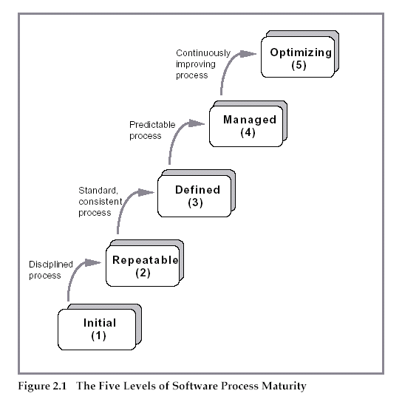
Five Levels of Software Process Maturity

Slide 25
Characteristics of Each Level
Initial Level (Level 1)
Characterized as ad hoc, and occasionally even chaotic
Few processes are defined, and success depends on individual effort
Repeatable (Level 2)
Basic project management processes are established to track cost, schedule, and functionality
The necessary process discipline is in place to repeat earlier successes on projects with similar applications

Slide 26
Characteristics of Each Level (continued)
Defined (Level 3)
The software process for both management and engineering activities is documented, standardized, and integrated into a standard software process for the organization
All projects use an approved, tailored version of the organization's standard software process for developing and maintaining software
Managed (Level 4)
Detailed measures of the software process and product quality are collected
Both the software process and products are quantitatively understood and controlled

Slide 27
Characteristics of Each Level (continued)
Optimized (Level 5)
Continuous process improvement is enabled by quantitative feedback from the process and from piloting innovative ideas and technologies

Slide 28
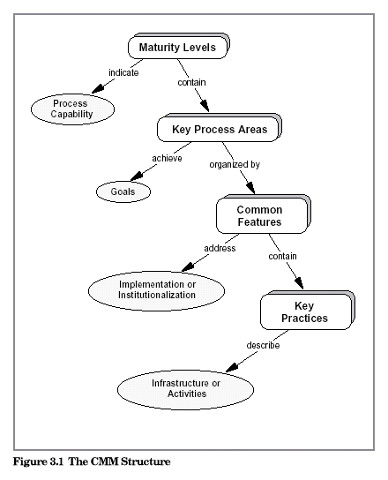
The CMM Structure

Slide 29
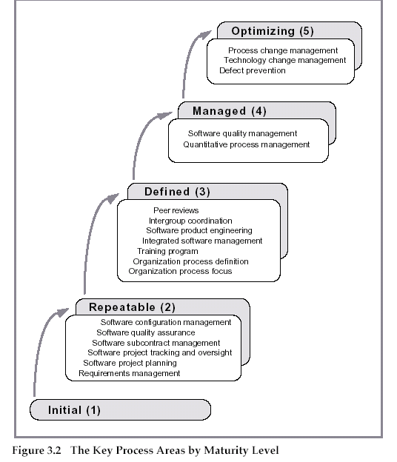
Key Process Areas

Slide 30
Prescriptive Process Models
Generic process framework (revisited)
Traditional process models
Specialized process models
The unified process
(Source: Pressman, R. Software Engineering: A Practitioner’s Approach. McGraw-Hill, 2005)

Slide 31
Generic Process Framework
Communication
Involves communication among the customer and other stake holders; encompasses requirements gathering
Planning
Establishes a plan for software engineering work; addresses technical tasks, resources, work products, and work schedule
Modeling (Analyze, Design)
Encompasses the creation of models to better under the requirements and the design
Construction (Code, Test)
Combines code generation and testing to uncover errors
Deployment
Involves delivery of software to the customer for evaluation and feedback
31

Slide 32
Modeling: Software Requirements Analysis
Helps software engineers to better understand the problem they will work to solve
Encompasses the set of tasks that lead to an understanding of what the business impact of the software will be, what the customer wants, and how end-users will interact with the software
Uses a combination of text and diagrams to depict requirements for data, function, and behavior
Provides a relatively easy way to understand and review requirements for correctness, completeness and consistency
32

Slide 33
Modeling: Software Design
Brings together customer requirements, business needs, and technical considerations to form the “blueprint” for a product
Creates a model that provides detail about software data structures, software architecture, interfaces, and components that are necessary to implement the system
Architectural design
Represents the structure of data and program components that are required to build the software
Considers the architectural style, the structure and properties of components that constitute the system, and interrelationships that occur among all architectural components
User Interface Design
Creates an effective communication medium between a human and a computer
Identifies interface objects and actions and then creates a screen layout that forms the basis for a user interface prototype
Component-level Design
Defines the data structures, algorithms, interface characteristics, and communication mechanisms allocated to each software component
33

Slide 34
Traditional Process Models

Slide 35
Prescriptive Process Model
Defines a distinct set of activities, actions, tasks, milestones, and work products that are required to engineer high-quality software
The activities may be linear, incremental, or evolutionary
35

Slide 36
Waterfall Model (Diagram)
Communication
Project initiation
Requirements gathering
Planning
Estimating
Scheduling
Tracking
Modeling
Analysis
Design
Construction
Code
Test
Deployment
Delivery
Support
Feedback
36

Slide 37
Waterfall Model (Description)
Oldest software lifecycle model and best understood by upper management
Used when requirements are well understood and risk is low
Work flow is in a linear (i.e., sequential) fashion
Used often with well-defined adaptations or enhancements to current software
37

Slide 38
Waterfall Model (Problems)
Doesn't support iteration, so changes can cause confusion
Difficult for customers to state all requirements explicitly and up front
Requires customer patience because a working version of the program doesn't occur until the final phase
Problems can be somewhat alleviated in the model through the addition of feedback loops (see the next slide)
38

Slide 39
Waterfall Model with Feedback (Diagram)
Communication
Project initiation
Requirements gathering
Planning
Estimating
Scheduling
Tracking
Modeling
Analysis
Design
Construction
Code
Test
Deployment
Delivery
Support
Feedback
39

Slide 40
Incremental Model (Diagram)
Increment #1
Communication
Planning
Modeling
Construction
Deployment
Increment #2
Communication
Planning
Modeling
Construction
Deployment
Increment #3
Communication
Planning
Modeling
Construction
Deployment
40

Slide 41
Incremental Model (Description)
Used when requirements are well understood
Multiple independent deliveries are identified
Work flow is in a linear (i.e., sequential) fashion within an increment and is staggered between increments
Iterative in nature; focuses on an operational product with each increment
Provides a needed set of functionality sooner while delivering optional components later
Useful also when staffing is too short for a full-scale development
41

Slide 42
Prototyping Model (Diagram)
Quick Planning
Communication
Start
Modeling
Quick Design
Deployment,
Delivery,
and Feedback
Construction
Of Prototype
42

Slide 43
Prototyping Model (Description)
Follows an evolutionary and iterative approach
Used when requirements are not well understood
Serves as a mechanism for identifying software requirements
Focuses on those aspects of the software that are visible to the customer/user
Feedback is used to refine the prototype
43

Slide 44
Prototyping Model (Potential Problems)
The customer sees a "working version" of the software, wants to stop all development and then buy the prototype after a "few fixes" are made
Developers often make implementation compromises to get the software running quickly (e.g., language choice, user interface, operating system choice, inefficient algorithms)
Lesson learned
Define the rules up front on the final disposition of the prototype before it is built
In most circumstances, plan to discard the prototype and engineer the actual production software with a goal toward quality
44

Slide 45
Spiral Model (Diagram)
Planning
Communication
Start
Modeling
Start
Deployment
Construction
45

Slide 46
Spiral Model (Description)
Invented by Dr. Barry Boehm in 1988 while working at TRW
Follows an evolutionary approach
Used when requirements are not well understood and risks are high
Inner spirals focus on identifying software requirements and project risks; may also incorporate prototyping
Outer spirals take on a classical waterfall approach after requirements have been defined, but permit iterative growth of the software
Operates as a risk-driven model…a go/no-go decision occurs after each complete spiral in order to react to risk determinations
Requires considerable expertise in risk assessment
Serves as a realistic model for large-scale software development
46

Slide 47
General Weaknesses of Evolutionary Process Models
Prototyping poses a problem to project planning because of the uncertain number of iterations required to construct the product
Evolutionary software processes do not establish the maximum speed of the evolution
If too fast, the process will fall into chaos
If too slow, productivity could be affected
Software processes should focus first on flexibility and extensibility, and second on high quality
We should prioritize the speed of the development over zero defects
Extending the development in order to reach higher quality could result in late delivery
47

Slide 48
Specialized Process Models

Slide 49
Component-based Development Model
Consists of the following process steps
Available component-based products are researched and evaluated for the application domain in question
Component integration issues are considered
A software architecture is designed to accommodate the components
Components are integrated into the architecture
Comprehensive testing is conducted to ensure proper functionality
Relies on a robust component library
Capitalizes on software reuse, which leads to documented savings in project cost and time
49

Slide 50
Formal Methods Model (Description)
Encompasses a set of activities that leads to formal mathematical specification of computer software
Enables a software engineer to specify, develop, and verify a computer-based system by applying a rigorous, mathematical notation
Ambiguity, incompleteness, and inconsistency can be discovered and corrected more easily through mathematical analysis
Offers the promise of defect-free software
Used often when building safety-critical systems
50

Slide 51
Formal Methods Model (Challenges)
Development of formal methods is currently quite time-consuming and expensive
Because few software developers have the necessary background to apply formal methods, extensive training is required
It is difficult to use the models as a communication mechanism for technically unsophisticated customers
51

Slide 52
The Unified Process

Slide 53
Background
Birthed during the late 1980's and early 1990s when object-oriented languages were gaining wide-spread use
Many object-oriented analysis and design methods were proposed; three top authors were Grady Booch, Ivar Jacobson, and James Rumbaugh
They eventually worked together on a unified method, called the Unified Modeling Language (UML)
UML is a robust notation for the modeling and development of object-oriented systems
UML became an industry standard in 1997
However, UML does not provide the process framework, only the necessary technology for object-oriented development
53

Slide 54
Background (continued)
Booch, Jacobson, and Rumbaugh later developed the unified process, which is a framework for object-oriented software engineering using UML
Draws on the best features and characteristics of conventional software process models
Emphasizes the important role of software architecture
Consists of a process flow that is iterative and incremental, thereby providing an evolutionary feel
Consists of five phases: inception, elaboration, construction, transition, and production
54

Slide 55
Phases of the Unified Process
Inception
Elaboration
planning
modeling
communication
construction
Construction
deployment
Production
Transition
55

Slide 56
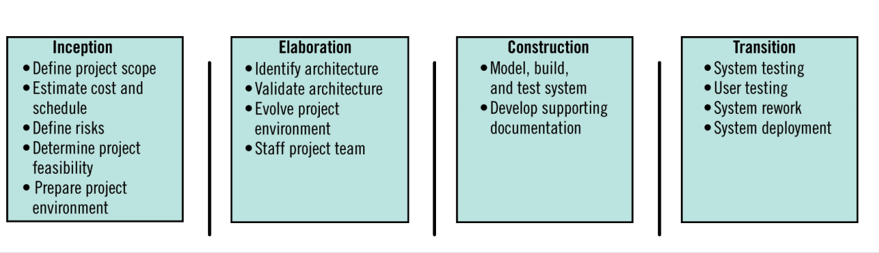
Major Workflow Produced in Unified Processes

Slide 57
Inception Phase
Encompasses both customer communication and planning activities of the generic process
Business requirements for the software are identified
A rough architecture for the system is proposed
A plan is created for an incremental, iterative development
Fundamental business requirements are described through preliminary use cases
A use case describes a sequence of actions that are performed by a user
57

Slide 58
Elaboration Phase
Encompasses both the planning and modeling activities of the generic process
Refines and expands the preliminary use cases
Expands the architectural representation to include five views
Use-case model
Analysis model
Design model
Implementation model
Deployment model
Often results in an executable architectural baseline that represents a first cut executable system
The baseline demonstrates the viability of the architecture but does not provide all features and functions required to use the system
58

Slide 59
Construction Phase
Encompasses the construction activity of the generic process
Uses the architectural model from the elaboration phase as input
Develops or acquires the software components that make each use-case operational
Analysis and design models from the previous phase are completed to reflect the final version of the increment
Use cases are used to derive a set of acceptance tests that are executed prior to the next phase
59

Slide 60
Transition Phase
Encompasses the last part of the construction activity and the first part of the deployment activity of the generic process
Software is given to end users for beta testing and user feedback reports on defects and necessary changes
The software teams create necessary support documentation (user manuals, trouble-shooting guides, installation procedures)
At the conclusion of this phase, the software increment becomes a usable software release
60

Slide 61
Production Phase
Encompasses the last part of the deployment activity of the generic process
On-going use of the software is monitored
Support for the operating environment (infrastructure) is provided
Defect reports and requests for changes are submitted and evaluated
61

Slide 62
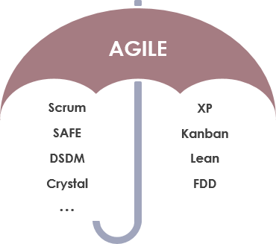
Agile Process Model

Slide 63
Agile is an umbrella term for a set of methods and practices based on the values and principles expressed in the Agile Manifesto

Slide 64
The Agile Manifesto
We are uncovering better ways of developing software by doing it and helping others do it. Through this work we have come to value:
Individuals and interactions over processes and tools
Working software over comprehensive documentation
Customer collaboration over contract negotiation
Responding to change over following a plan
That is, while there is value in the items on the right, we value the items on the left more.

Slide 65
12 Principles Behind Manifesto
Our highest priority is to satisfy the customer through early and continuous delivery of valuable software.
Welcome changing requirements, even late in development. Agile processes harness change for the customer’s competitive advantage.
Deliver working software frequently, from a couple of weeks to a couple of months, with a preference to the shorter timescale.
Business people and developers must work together daily throughout the project.
Build projects around motivated individuals. Give them the environment and support they need, and trust them to get the job done.
The most efficient and effective method of conveying information to and within a development team is face-to-face conversation.

Slide 66
Continue..
Working software is the primary measure of progress.
Agile processes promote sustainable development. The sponsors, developers, and users should be able to maintain a constant pace indefinitely.
Continuous attention to technical excellence and good design enhances agility.
Simplicity–the art of maximizing the amount of work not done–is essential.
The best architectures, requirements, and designs emerge from self-organizing teams.
At regular intervals, the team reflects on how to become more effective, then tunes and adjusts its behavior accordingly.

Slide 67
The two dominant Agile approaches are Scrum and eXtreme Programming (XP).
XP was arguably the first method deemed to be “Agile”.
We will start with Scrum – very popular and in very wide use today!

Slide 68
Scrum Terminology
Product Owner:
Scrum Master:
Scrum/Development Team:
Product Backlog
Sprint Backlog
Sprint

Slide 69
Project Management Emphasis based on a Standard 30-day Sprint
Scrum: a definite project management emphasis.
Scrum Master: A Scrum project Is managed by a Scrum Master, who can be considered as much a consultant or coach as a manager.
Sprint. Scrum has a fundamental 30-day development cycle called a Sprint, preceded by
pre-Sprint activities and post-Sprint activities.
Daily Scrum: A short (less than 30 minutes) daily Scrum Meeting allows the team to monitor status and communicate problems.

Slide 70
Product Backlog for Planning
Project planning is based on a Product Backlog, which contains
functions and
technology enhancements
envisioned for the project.
Two meetings are held –
one to decide the features for the next Sprint and
the other to plan out the work.

Slide 71
Core Roles – Product Owner
The Product Owner represents stakeholders and is the voice of the customer.
Product Owner is accountable for ensuring that the team delivers value to the business.
Product Owner
writes customer-centric items (typically user stories),
prioritizes them, and
adds them to the product backlog.
Note:
Scrum teams should have one Product Owner.
May also be a member of the development team
Not recommend this person be Scrum Master.

Slide 72
Core Roles – Development/Scrum Team
The Development Team is responsible for delivering potentially shippable product increments at end of each Sprint.
Team = 3–9 people with cross-functional skills.
Team does actual work
(analyze, design, develop, test, technical communication, document, etc.).
Team is self-organizing, even though they may interface with project management organizations (PMOs).

Slide 73
Core Roles – Scrum Master
Scrum is facilitated by a Scrum Master –
Accountable for removing impediments for team to deliver sprint goal / deliverables.
Scrum Master is not the team leader, but acts as a buffer between the team and any distracting influences.
Scrum Master ensures process is used as intended.
Scrum Master is the enforcer of rules.
Scrum Master’s role: protect the Team and keep it focused on the tasks at hand.

Slide 74
